Slide 1




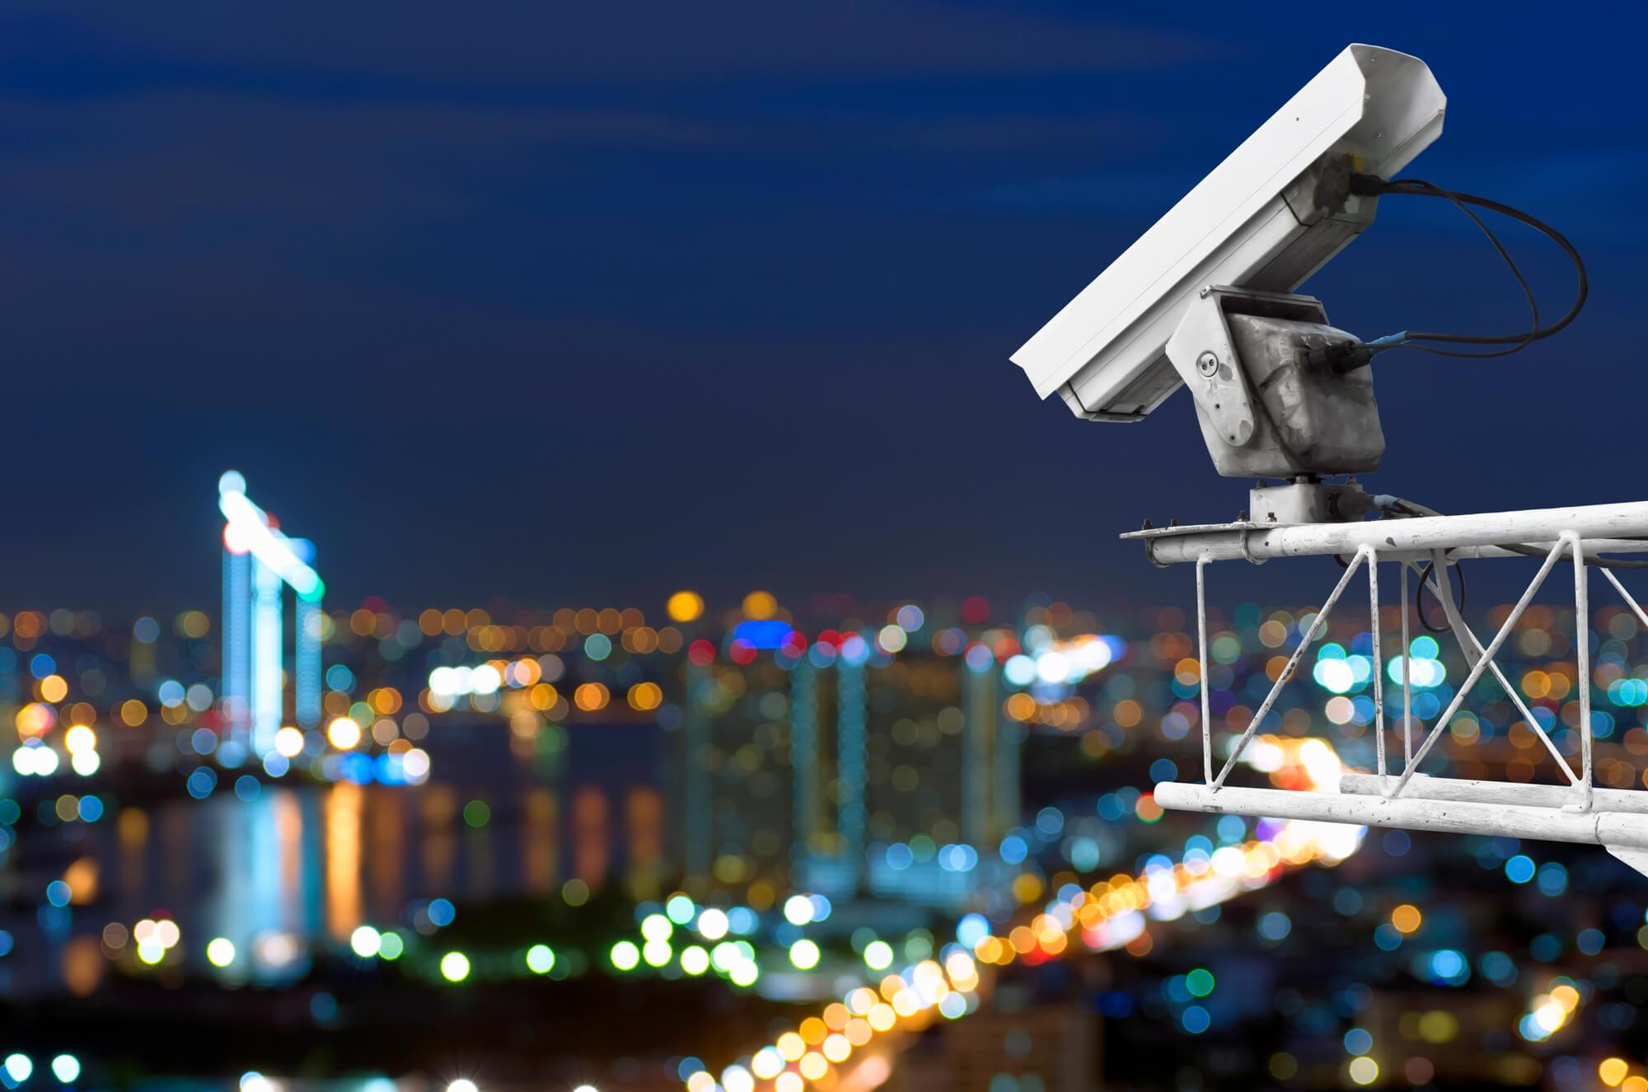



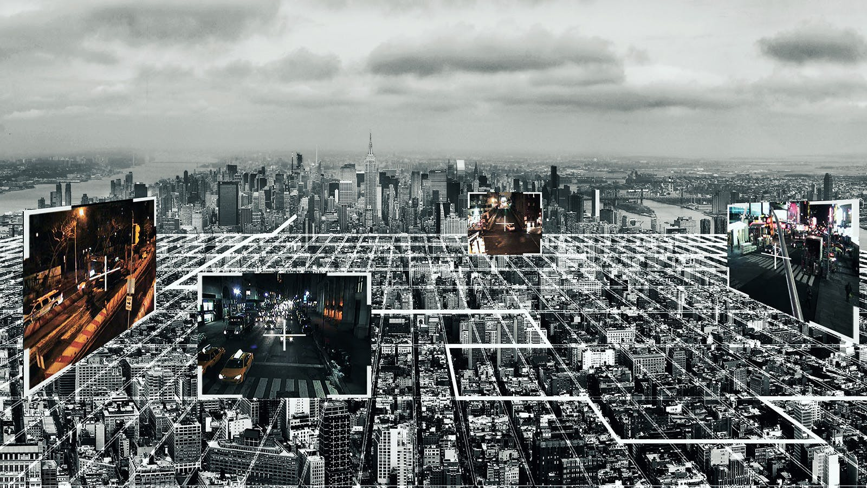
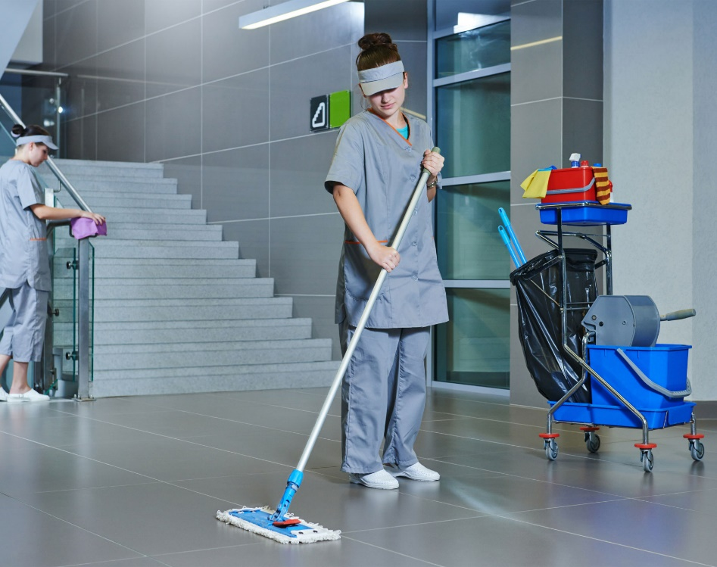
WE ARE EXPANDING EVERY DAY

Slide 2
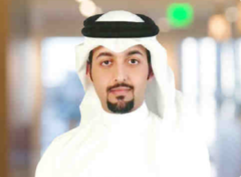
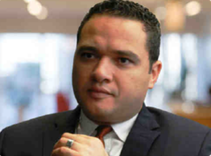
STAKEHOLDERS
H.E. Sheikh Nasser Bin Abdul Rahman Al Thani
Chairman
Eng. Ahmed Mokhtar
CEO
Our Chairman promotes effective relationships and establishes good corporate practices and procedures and promotes the highest standards of integrity, probity and corporate governance throughout the Group and particularly at Board level.
Our Chief Executive Officer provides the mandate and leadership for the Executive Team to work in partnership across our operational groups; he leads and implements continuous improvements in business processes and ensuring delivery of customer centric services.

Slide 3
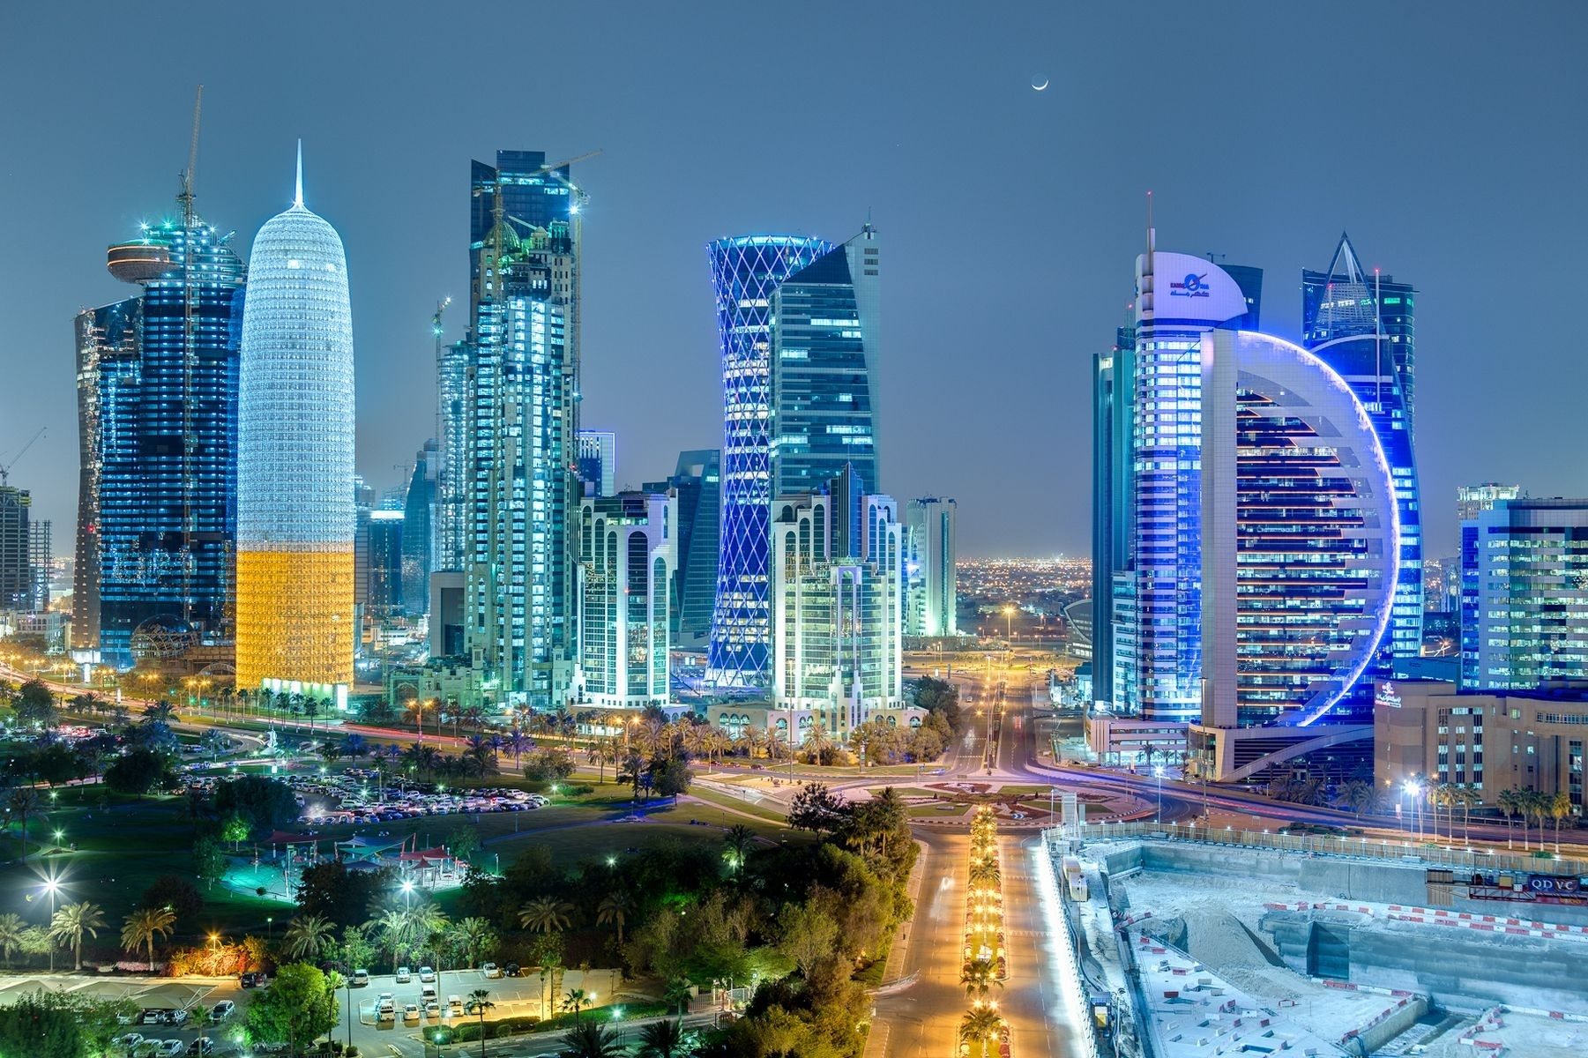
BRIEF INTRODUCTION
With more than 8 Years of experience in physical security systems, lighting, ELV, fire fighting & fire alarm, Remal International is offering end to end solutions to the Qatari Market .
Partnering with the leading Vendors in the field we have successfully Implemented many projects in Qatar

Slide 4
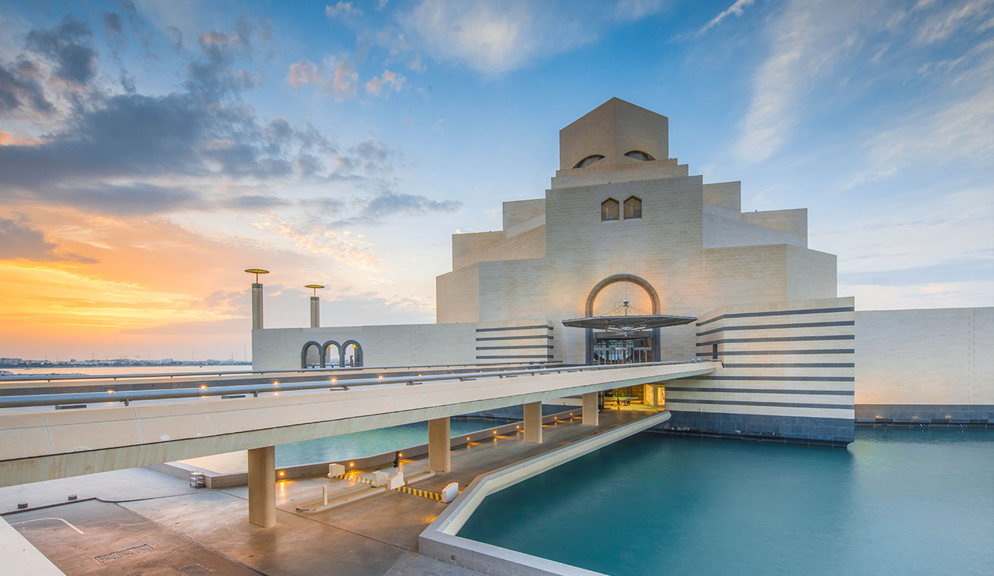
WE ARE EXPANDING EVERY DAY
COMPANY TIMELINE
Remal Security has been established to comply local authorities norms and procedures in security systems
Remal extends the reach by opening it’s first branch outside Qatar, by introducing Remal Projects in Egypt.
Re-branding is done. This gave birth to Remal International and the journey is still on...
2011
2014
2016
2013
2015
2018
Heliopolis Technical Services was established with ELV systems as its core business.
Remal expanded its local business with establishment of Remal First Class.
Remal diversifies again and introduces F&B to it’s wide range of services and products
With Sweet Treats & Lab Cafe

Slide 5




MISSION, VISION &VALUES
Secure our clients from intruders and
Meet Our Clients Targets & Expectations
Provide Fast, reliable solutions and competent After Sales Support.
We are delivering unique, tailor made and cost effective solutions

Slide 6

REMAL IN FIGURES
Remal International was established in 2011 and has been active in the Qatar market as a renowned system integrator for Fire & Safety, Security, and ELV system.
More than 200 completed projects and keep on increasing.
More that 10.000 CCTV installed.
Projects worth of 65.000.000 in 2018.
More than 400 employees that work together to fulfil their mission and soon we will reach 500.
Solution partners from all around the world.

Slide 7
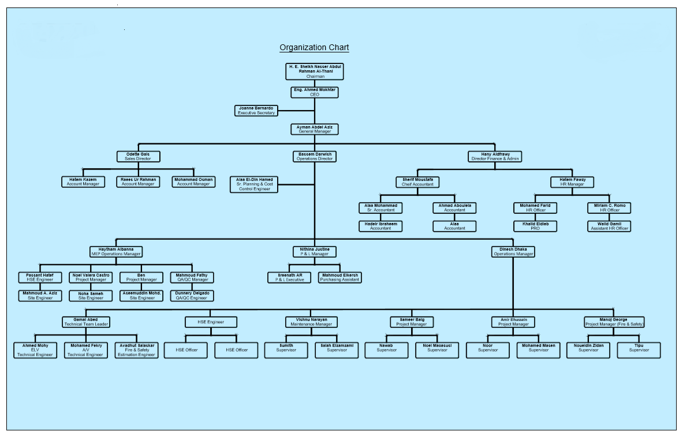
OUR TEAM
WE BELIVE IN OUR TEAM

Slide 8



WHY REMAL?
Real, unique, tailor made and cost effective solutions.
Excellent value on time, every time.
Meet customer’s unique security requirements.
Adequate maintenance of security systems.
Leading security system partner, manufacturer and supplier.
WE ARE THE SOLUTION

Slide 9
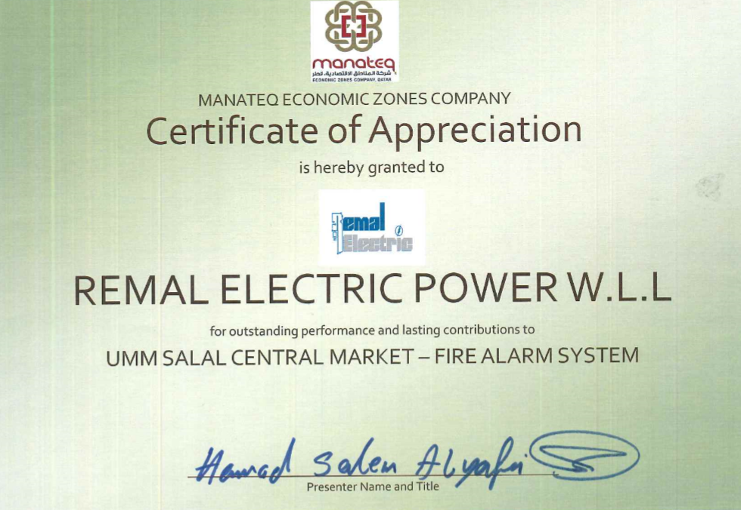
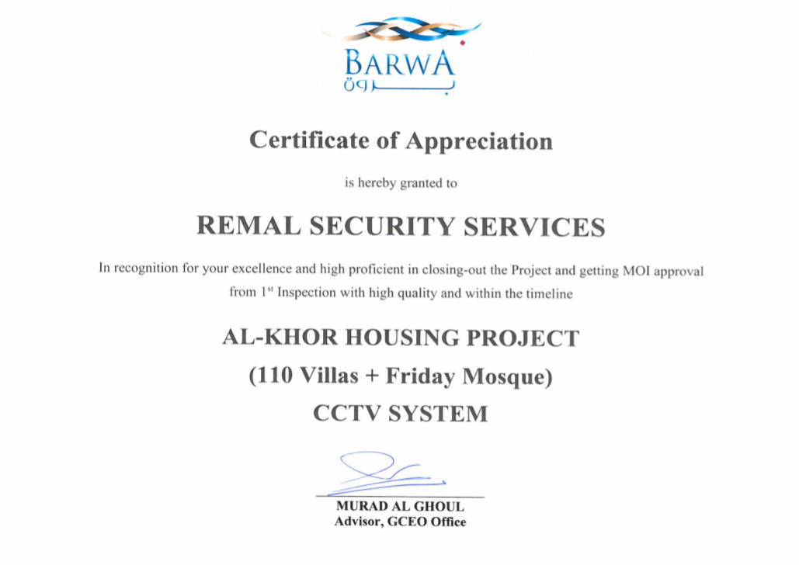

Slide 10
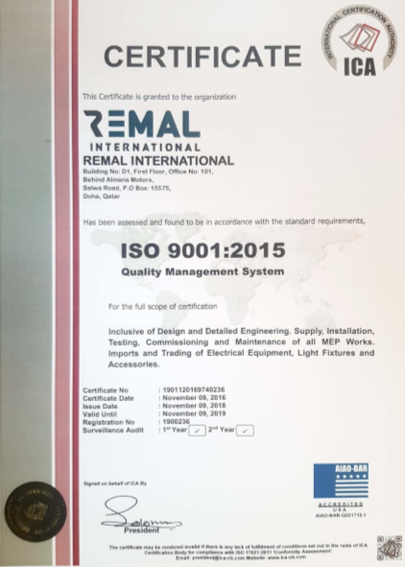
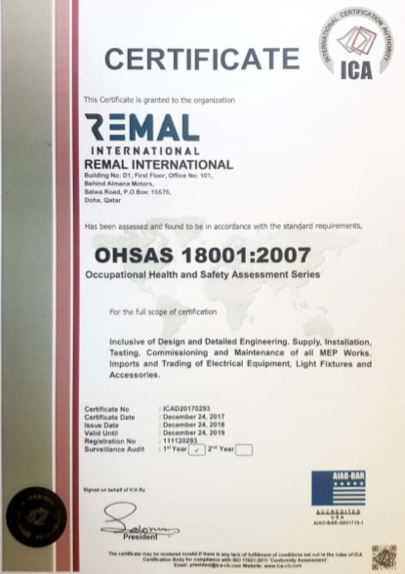

Slide 11
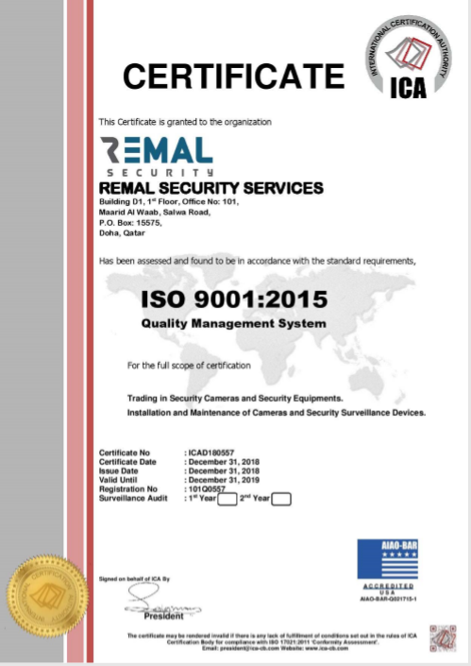
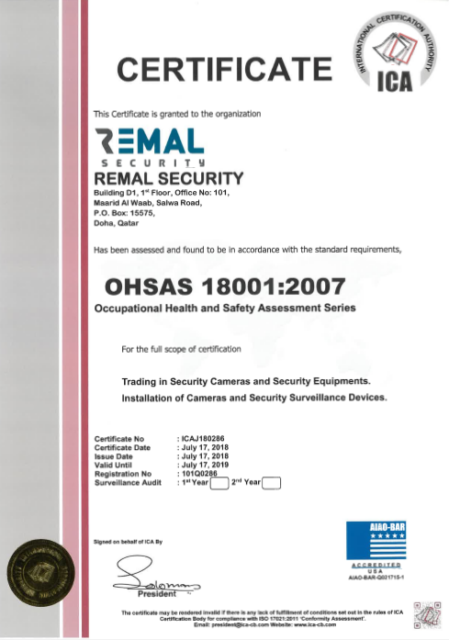

Slide 12




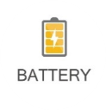





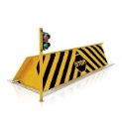
Physical Security Information System
Fire Fighting & Fire Alarm
MEP
CCTV System
Public address System
Physical Security System
Car Parking System
Lighting System
Central Battery
Access Control System
MEP
CCTV SYSTEMS
PHYSICAL SECURITY INFORMATION MANAGEMENT SYSTEM
CENTRAL BATTERY
ACCESS CONTROL SYSTEMS
SOLUTIONS
WE OFFER
LIGHTING SYSTEMS
FIRE ALARM & FIRE FIGHTING
PHYISICAL SECURITY SYSTEMS
CAR PARKING SYSTEMS
PUBLIC ADDRESS SYSTEMS

Slide 13
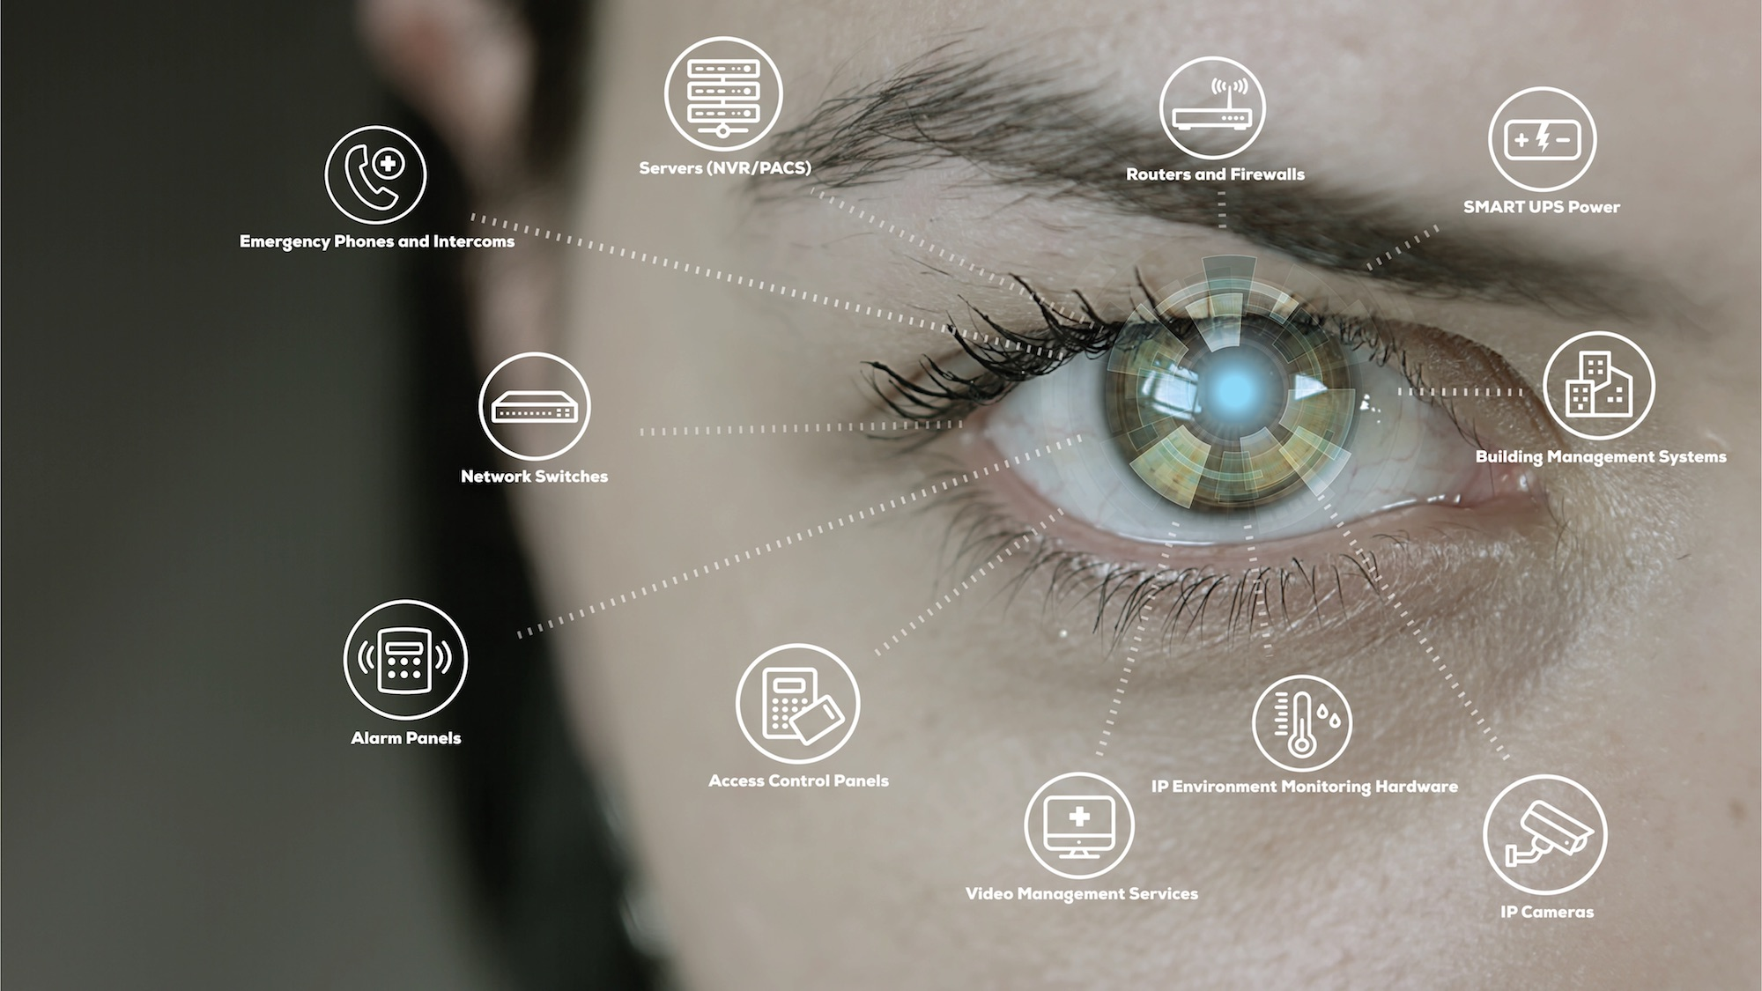


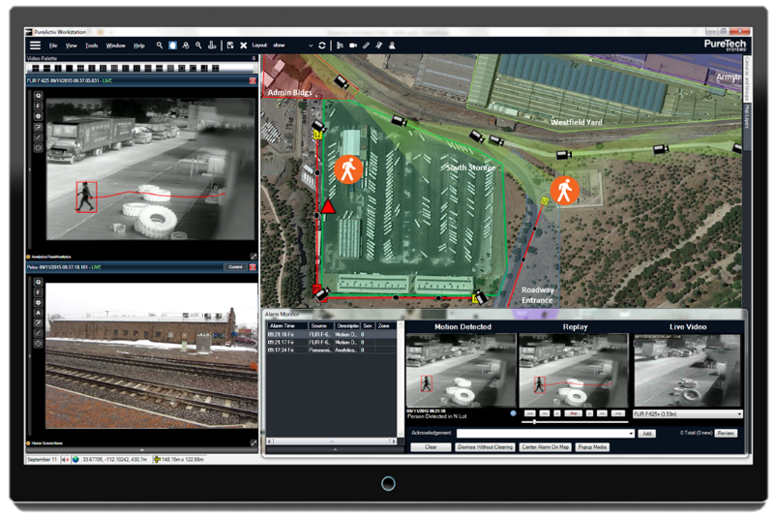
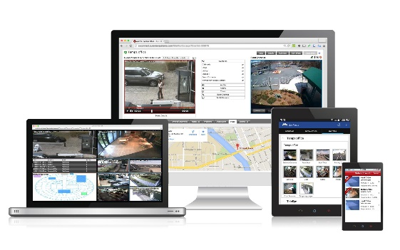
PHYISICAL SYCURITY INFORMATION SYSTEM - PSIM
Physical Security Information Management PSIM system can tie various security systems together to provide a single interface for total security control.

Slide 14
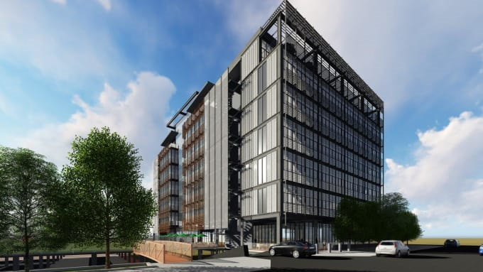
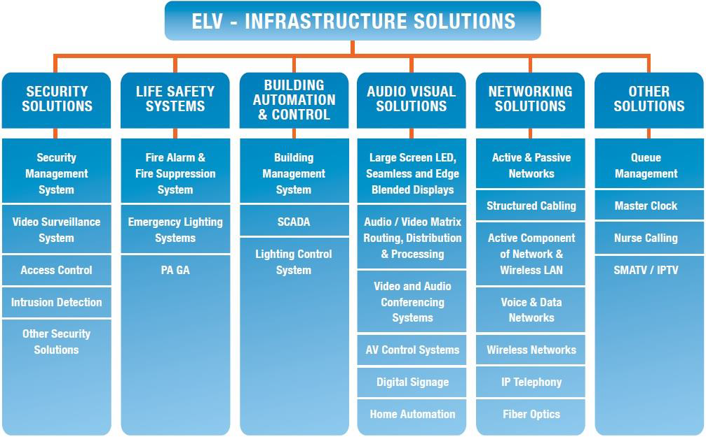

Slide 15
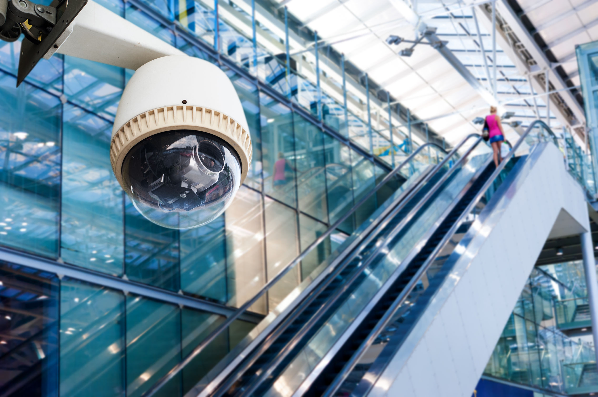










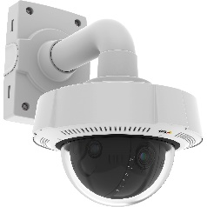
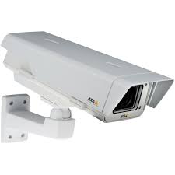
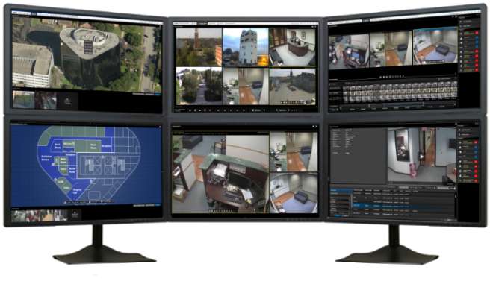
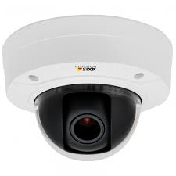
CCTV SURVILLENCE SYSTEM
End to End IP video surveillance solutions
HD CCTV Cameras
Video Analytics (Left object, Loitering, Perimeter Intrusion etc.)
Video Wall, Display Screens
High End Servers, Work Stations and Storages
Video Management System Software
API, SDK for Integration with Access Control and third Party System

Slide 16





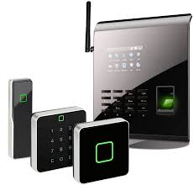
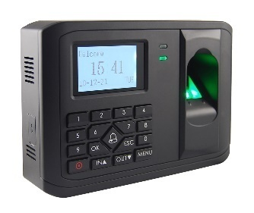
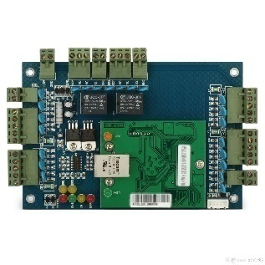
ACCESS CONTROL SYSTEM
We offer Access control solutions ranging from single door stand alone systems to multi door access systems to fully-featured integrated solutions for controlling access to multiple facilities with complex requirements.
Access card reader
Long range reader
Biometric: facial, finger print, palm reader
Access cards: MIFARE, DESfire, OmniiClass, iClass, Proximity etc
Magnetic/Strike locks
Door sensors
Exit buttons-push buttons and infrared types
Access control management and photo badging software

Slide 17





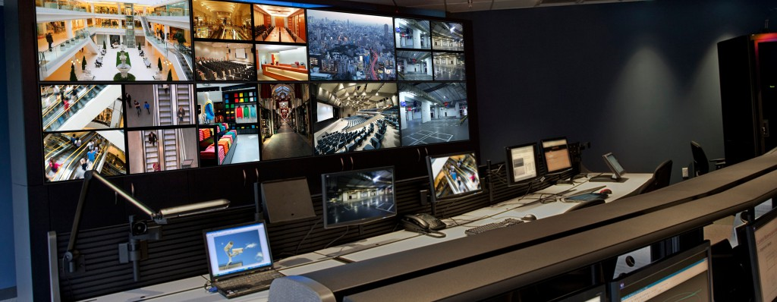
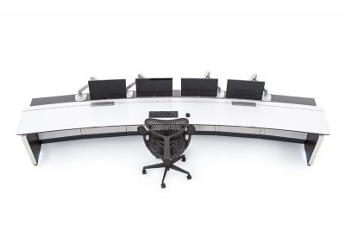
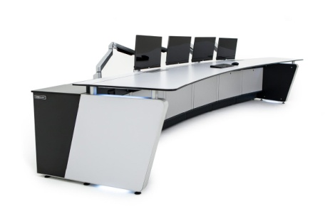
COMMAND AND CONTROL CENTER

Slide 18







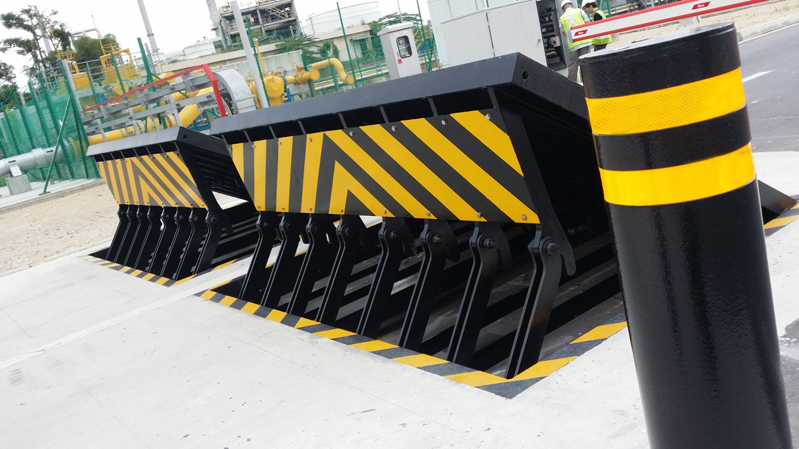
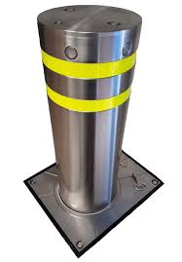
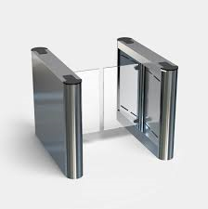
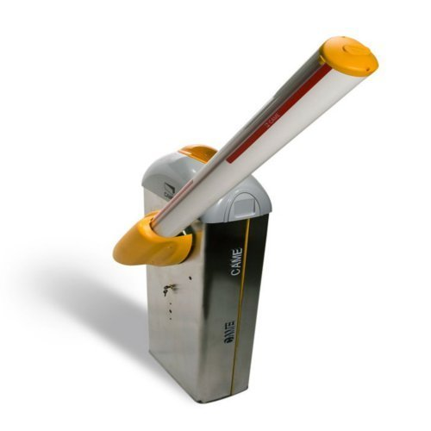
PHYSICAL SECURITY SYSTEMS
Wide range of Physical security solutions for commercial and Military purposes.
Remal features some of the world’s highly talented workforce to make sure that we deliver a secured network. We take complete care of data protection, secure operations, and information security. In fact, many customers from sensitive ﬁeld like health, security, and banking rely on us.

Slide 19



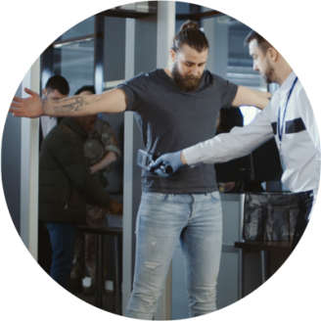
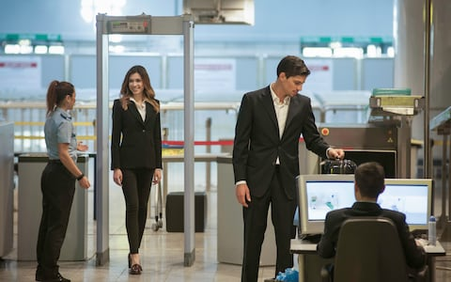
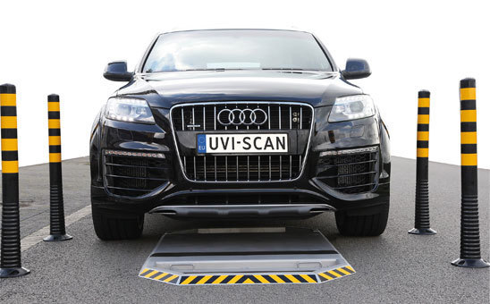
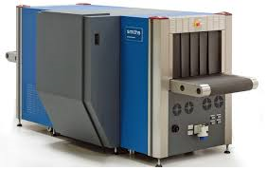
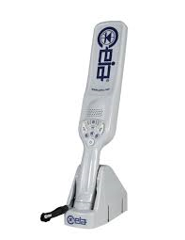
X-RAY INSPECTION & METAL DETECTION SYSTEM
X-ray Inspection/Baggage Scanning System
Walk Through and Hand Held Metal Detectors
Under Vehicle Scanning System

Slide 20




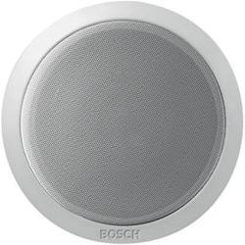
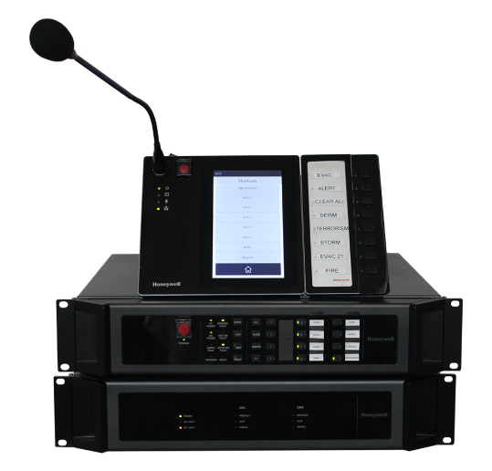
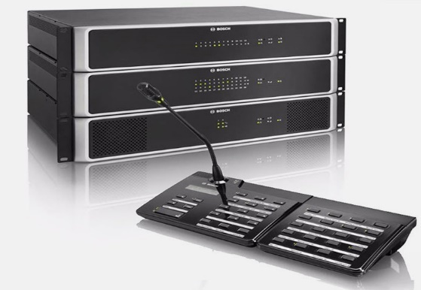
PUBLIC ADDRESS SYSTEM
High-quality public address and voice evacuation solutions suitable for Small Retail to large buildings. We have solutions ranging from simple analogue PA/BGM system to fully digital, networked, public address system using CobraNet technology. We also implement sound reinforcement systems for live music or concert in auditoriums.

Slide 21






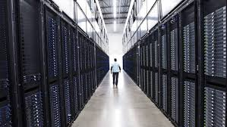

STRUCTURED CABLING
We offer excellence in planning, design, installation, and maintenance of structured network cable infrastructure that is flexible and scalable to your business needs. Whether your requirement is Cat 6, Cat 6A, or Cat 7, we provide end-to-end passive network infrastructure for copper and ﬁber solutions, keeping the TIA/EIA standards in mind.

Slide 22
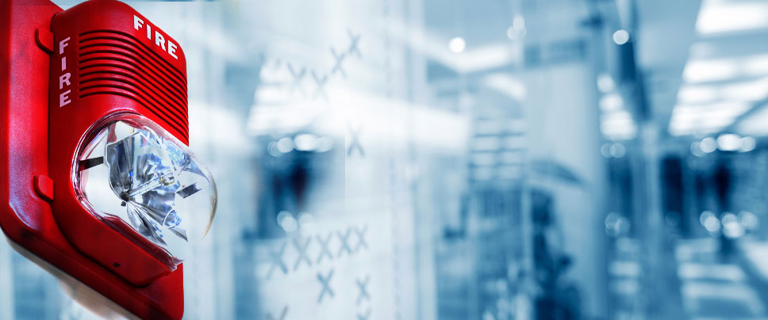


FIRE ALARM SYSTEM
Conventional Fire Alarm System
Addressable Fire Alarm System
Aspirating Smoke Detection (ASD) System
Gas Detection System
Emergency Lighting System
Sectors covered
Residential and commercial buildings
Oil & Gas Sites
Industrial Sites

Slide 23
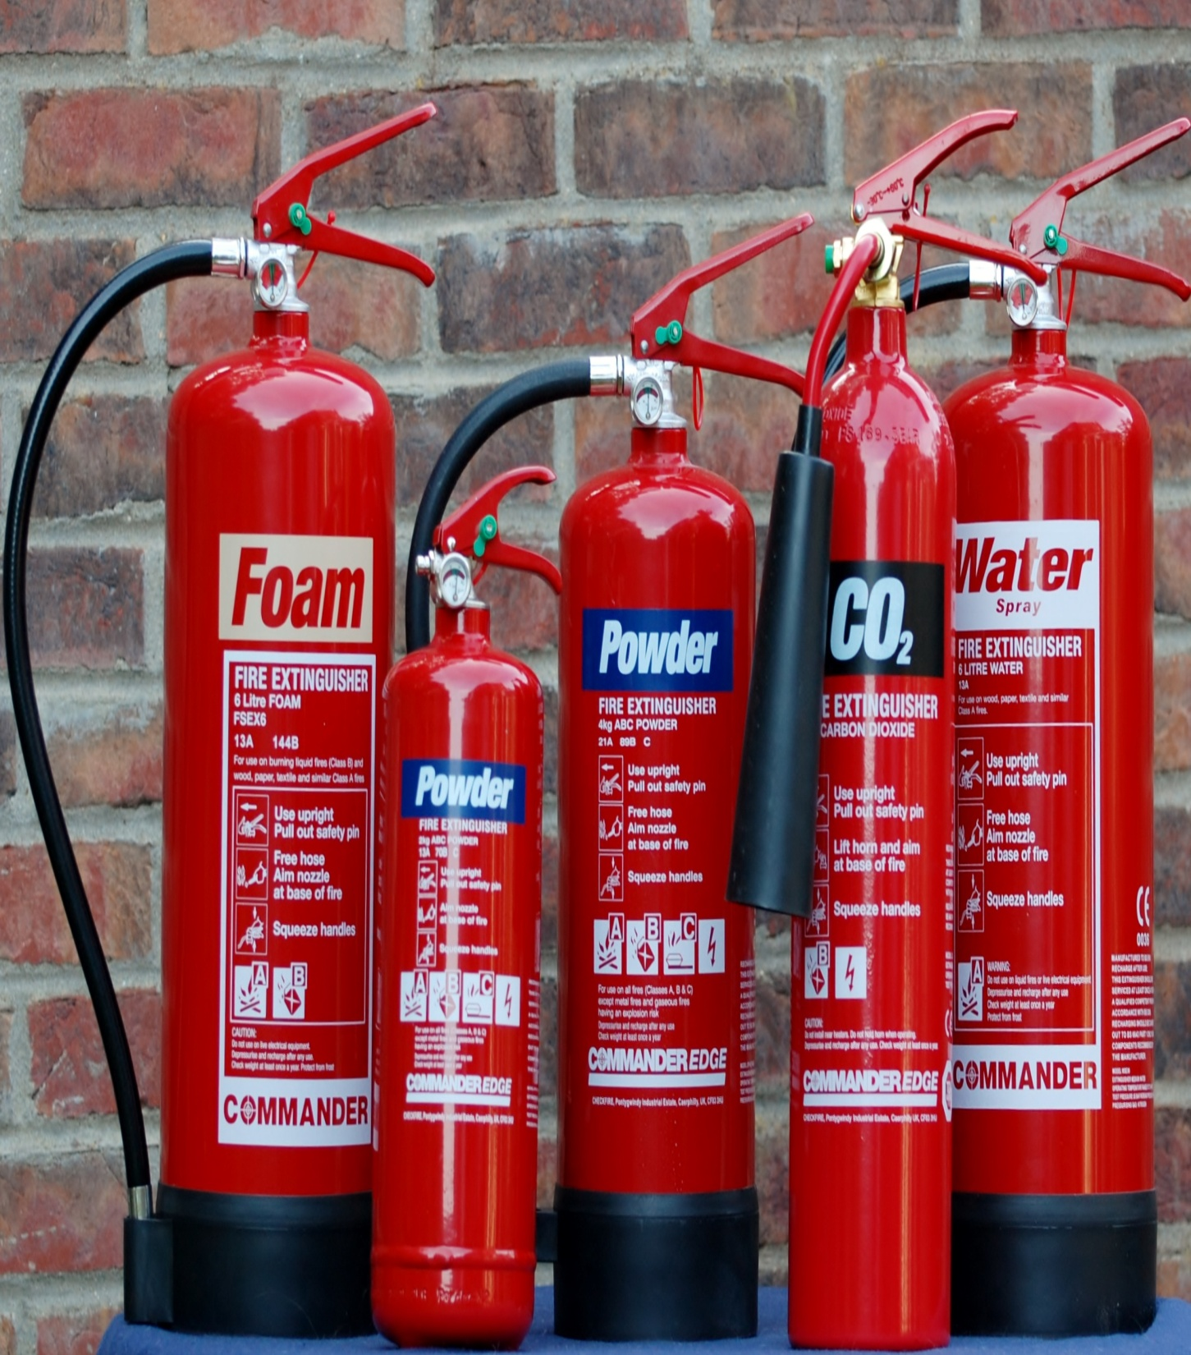




FIRE FIGHTING SYSTEM
Gas Suppression System
-FM 200
-Inert Gas System
-CO2 System
Deluge Sprinkler & Foam System
Kitchen Hood Wet Chemical Suppression System
Fire Fighting Pumps
-Vertical turbine pump
-End section centrifugal pump
-Horizontal split case pump
Sprinkler system
Fire hose reels & Fire Extinguishers

Slide 24


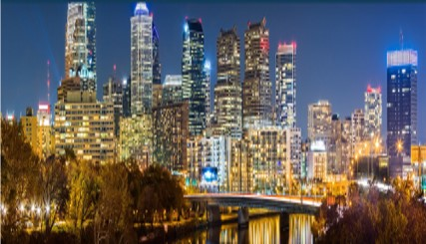
CENTRAL BATTERY/ SERVICE CENTRE
Emergency Power Backup Solutions for
University Campus
Hospitals
Traffic Signals
Residential & Commercial Buildings
Airports
Banks
CCTV Surveillance
Support all lamp sources, including HID, electronic
Low voltage, Fluorescent, LED, Quartz, Incandescent,
and Mixed loads.
Capacities ranging from 110VA/W — 50kVA/kW

Slide 25
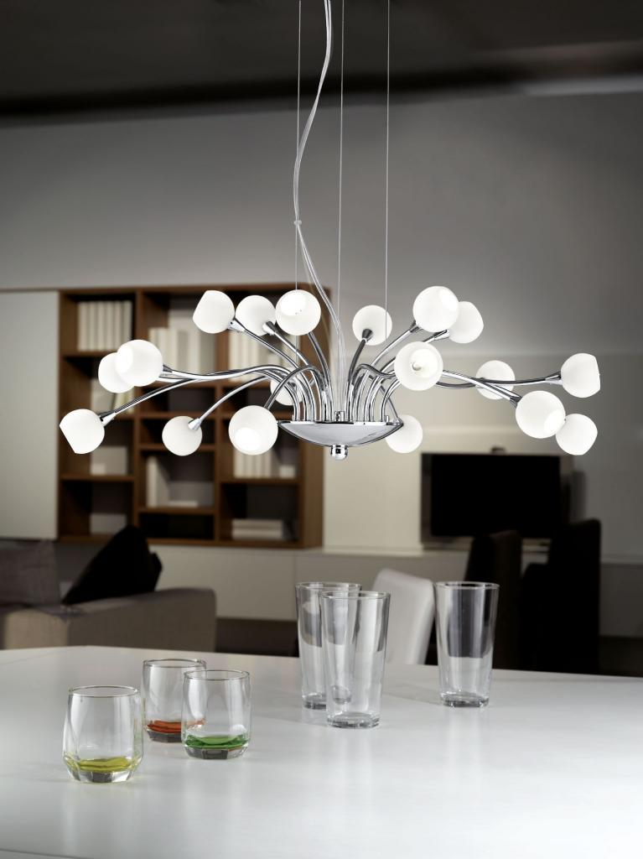







LIGHTING
Our engineering potential and collaboration with leading manufacturers bind the best products and technologies to create an ultimate customer experience.
Architectural Lighting
Façade Lighting
LED Lighting
Stadium Lighting
Street Lighting
Emergency Lighting

Slide 26
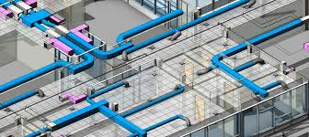


MEP

Slide 27




OUR CLIENTS

Slide 28





CONSULTANTS

Slide 29


CONTRACTORS

Slide 30


CLIENT: QATAR ARMED FORCES
SCOPE OF WORK : Renovation of Medical Services at Midmac
SYSTEMS IMPLEMENTED BY REMAL:
CCTV
Access Control
Structured Cabling
Fire Alarm
Fire Fighting
Lighting
CLIENT: QATAR ARMED FORCES
SCOPE OF WORK: Bosir Camp (New Gate)
SYSTEMS IMPLEMENTED BY REMAL:
CCTV

Slide 31


CLIENT: QATAR AIRWAYS
SYSTEMS IMPLEMENTED BY REMAL:
CCTV
STRUCTURED CABLING
LIGHTING
Central Battery System Bypass Switch
CLIENT: Hamad International Airport (HIA)
SYSTEMS IMPLEMENTED BY REMAL:
Central Inverter Unit
Central Battery System

Slide 32

CLIENT: ASHGHAL
SCOPE OF WORK : Coast Guard Station at Ras Matbakh
SYSTEMS IMPLEMENTED BY REMAL:
CCTV
Access Control
Structured Cabling
Public Address
CLIENT: ASHGHAL
SCOPE OF WORK : Coast Guard Station at Shwaimsah
SYSTEMS IMPLEMENTED BY REMAL:
CCTV
Access Control
Structured Cabling
Public Address

Slide 33

CLIENT: MANATEQ
SCOPE OF WORK : Design & build of Light
Industrial at Ras Bufontas &
Umm Al houl
SYSTEMS IMPLEMENTED BY REMAL:
CCTV
AV
Structured Cabling
Lighting
CLIENT: MANATEQ
SCOPE OF WORK :
Construction of New Central
Markets at Al Wakra
SYSTEMS IMPLEMENTED BY REMAL:
CCTV
AV
Structured Cabling
Lighting

Slide 34


CLIENT: QATARI DIAR
PROJECT: QIB Bank (Messaied Branch)
SYSTEMS IMPLEMENTED BY REMAL:
Light Fixtures
CLIENT: MSHEIREB PROPERTIES
PROJECT: Al Khaliji Bank (2B+G+2F)
SYSTEMS IMPLEMENTED BY REMAL:
Structured Cabling
Central Battery System

Slide 35


CLIENT:
Qatar Islamic Bank
Projects:QIB Bank (Messaied Branch)
SYSTEMS IMPLEMENTED BY REMAL:
PABX System
CLIENT:
Qatar International Bank
Projects : QIB Hotel
SYSTEMS IMPLEMENTED BY REMAL:
Structured Cabling

Slide 36


CLIENT:
KATARA HOSPITALITY
SYSTEMS IMPLEMENTED BY REMAL:
CCTV
AV
Structured Cabling
Lighting
CLIENT:
KAHRAMAA
Projects:
Al Thumama Branch
SYSTEMS IMPLEMENTED BY REMAL:
CCTV
Gate Barriers
Access Control
Turnstiles

Slide 37


CLIENT : Msheireb Properties
SYSTEMS IMPLEMENTED BY REMAL:
Central Battery
CLIENT : Porto Arabia
SYSTEMS IMPLEMENTED BY REMAL:
CCTV
AV
Structured Cabling
Lighting

Slide 38


CLIENT:AL Meera
SYSTEMS IMPLEMENTED BY REMAL:
CCTV
Fire Alarm
PROJECT:CENTRAL MARKET
SYSTEMS IMPLEMENTED BY REMAL:
Lighting
Structured Cabling

Slide 39
ANY QUESTIONS? THANK YOU!

